Slide 1

CUSTOMER SHOPPING BEHAVIOR ANALYSIS
This project analyzes customer shopping behavior using transactional data from 3,900 purchases. Our goal is to uncover insights into spending patterns, customer segments, product preferences, and subscription behavior to guide strategic business decisions.

Slide 2


PROJECT OVERVIEW & DATASET SUMMARY
PROJECT GOAL
DATASET AT A GLANCE
Uncover insights into spending patterns, customer segments, product preferences, and subscription behavior to guide strategic business decisions.
3,900 Rows, 18 Columns
Key Features: Demographics, Purchase Details, Shopping Behavior
Missing Data: 37 values in Review Rating

Slide 3

EXPLORATORY DATA ANALYSIS (PYTHON)
1
DATA LOADING & EXPLORATION
Imported dataset using pandas and checked structure/summary statistics.
2
MISSING DATA HANDLING
Imputed missing 'Review Rating' values using median per product category.
3
FEATURE ENGINEERING
Created 'age_group' and 'purchase_frequency_days' columns.
4
DATABASE INTEGRATION
Loaded cleaned data into PostgreSQL for SQL analysis.

Slide 4


KEY BUSINESS INSIGHTS FROM SQL ANALYSIS
REVENUE BY GENDER
Male customers generated $157,890, females $75,191.
HIGH-SPENDING DISCOUNT USERS
839 customers used discounts but spent above average.
TOP 5 PRODUCTS BY RATING
Gloves, Sandals, Boots, Hat, Skirt had highest average ratings.
SHIPPING TYPE
Express shipping had higher average purchase amounts ($60.48 vs $58.46).

Slide 5

SUBSCRIPTION & DISCOUNT ANALYSIS
SUBSCRIBERS VS. NON-SUBSCRIBERS
DISCOUNT-DEPENDENT PRODUCTS
Products with highest percentage of discounted purchases:
Yes
1053
59.49
62645.00
Hat (50%)
No
2847
59.87
170436.00
Sneakers (49.66%)
Coat (49.07%)
Sweater (48.17%)
Pants (47.37%)

Slide 6



CUSTOMER SEGMENTATION & LOYALTY
RETURNING CUSTOMERS
701 customers
NEW CUSTOMERS
83 customers
LOYAL CUSTOMERS
3116 customers
Customers with >5 purchases: 958 are subscribers, 2518 are not.

Slide 7
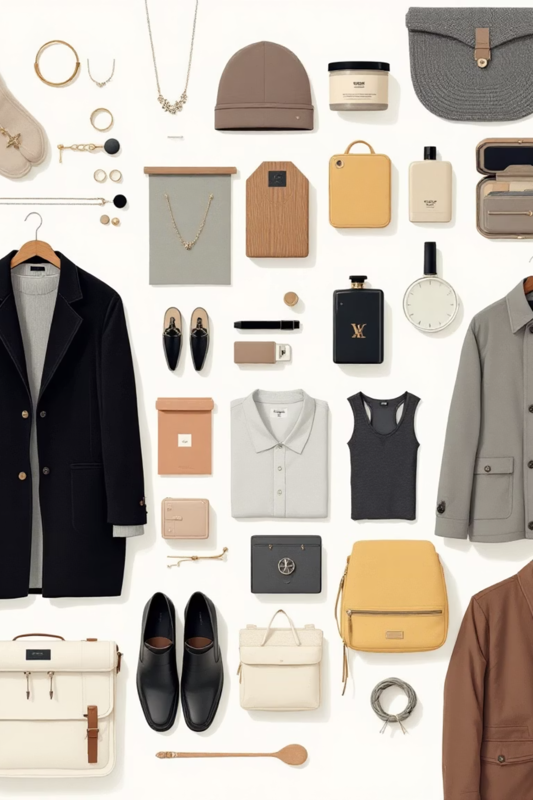
TOP PRODUCTS BY CATEGORY
ACCESSORIES
1
Jewelry (171 orders)
Sunglasses (161 orders)
Belt (161 orders)
CLOTHING
2
Blouse (171 orders)
Pants (171 orders)
Shirt (169 orders)
FOOTWEAR
3
Sandals (160 orders)
Shoes (150 orders)
Sneakers (145 orders)
OUTERWEAR
4
Jacket (163 orders)
Coat (161 orders)

Slide 8
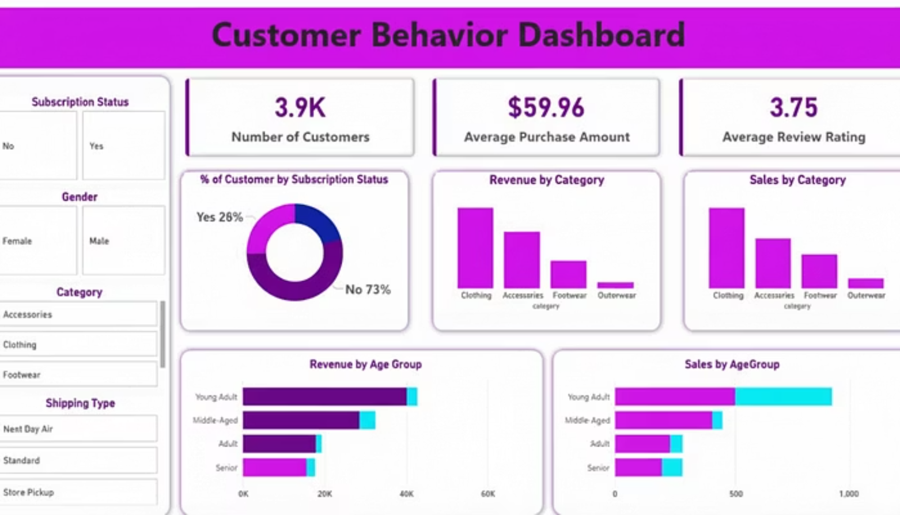
INTERACTIVE DASHBOARD IN POWER BI
An interactive Power BI dashboard was created to visualize key insights:
Key Metrics: 3.9K Customers, $59.76 Average Purchase, 3.75 Average Review Rating.

Slide 9





BUSINESS RECOMMENDATIONS
BOOST SUBSCRIPTIONS
Promote exclusive benefits to increase subscriber base.
CUSTOMER LOYALTY PROGRAMS
Reward repeat buyers to foster loyalty and move them to the "Loyal" segment.
REVIEW DISCOUNT POLICY
Balance sales boosts with margin control for sustainable growth.
TARGETED MARKETING
Focus efforts on high-revenue age groups and express-shipping users.

